Slide 1
Attributes of God
KIM Mission Seminar
7 September 2023
ALLPPT.com _ Free PowerPoint Templates, Diagrams and Charts

Slide 2


AW Tozer

Slide 3
Does God Exist?
In the beginning God created the heavens and earth. (Genesis 1:1)
ALLPPT.com _ Free PowerPoint Templates, Diagrams and Charts

Slide 4
What Kind of God?
Three religious world-views and their major religions

Slide 5
What Kind of God?
Three religious world-views and their major religions
Theism: GOD MADE ALL (Judaism, Christianity, Islam)

Slide 6
What Kind of God?
Three religious world-views and their major religions
Theism: GOD MADE ALL (Judaism, Christianity, Islam)
Pantheism: GOD IS ALL (Zen Buddhism, Hinduism)

Slide 7
What Kind of God?
Three religious world-views and their major religions
Theism: GOD MADE ALL (Judaism, Christianity, Islam)
Pantheism: GOD IS ALL (Zen Buddhism, Hinduism)
Atheism: NO GOD AT ALL (Religious, Humanism)

Slide 8
What Kind of God?
Three religious world-views and their major religions
Theism: GOD MADE ALL (Judaism, Christianity, Islam)
Pantheism: GOD IS ALL (Zen Buddhism, Hinduism)
Atheism: NO GOD AT ALL (Religious, Humanism)
An agnostic literally means “not to know.” With regard to God, an agnostic is
Someone who does not know whether or not God exists.

Slide 9
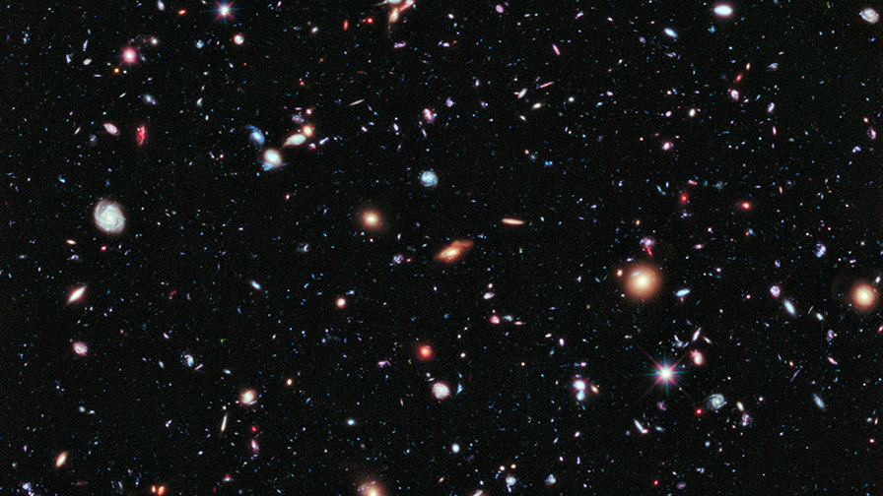
Does God Exist?
The Cosmological Argument

Slide 10
Does God Exist?
The Cosmological Argument
The Beginning of the End for Atheism

Slide 11
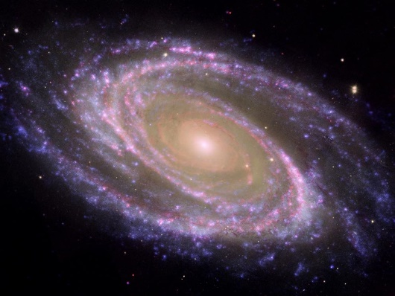
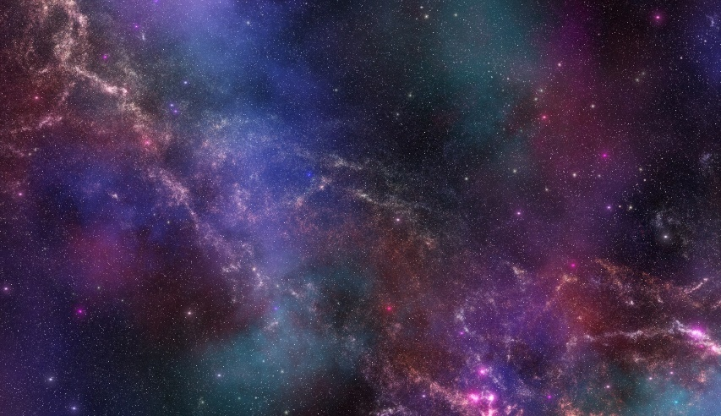
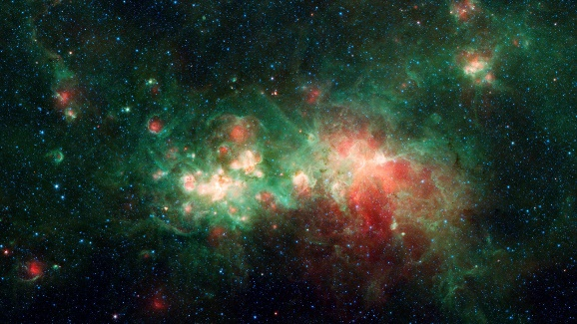
Does God Exist?
The Cosmological Argument
Although we don’t physically see God because He is not a material Being, we know He
Exists by His effects. One effect appears to be the universe itself.

Slide 12
The Cosmological Argument
SURGE
S Second Law of Thermodynamics

Slide 13
The Cosmological Argument
SURGE
S Second Law of Thermodynamics
U Universe is Expanding

Slide 14
The Cosmological Argument
SURGE
S Second Law of Thermodynamics
U Universe is Expanding
R Radiation Afterglow (the remnant heat from the Big Bang Explosion)

Slide 15
The Cosmological Argument
SURGE
S Second Law of Thermodynamics
U Universe is Expanding
R Radiation Afterglow (the remnant heat from the Big Bang Explosion)
G Great Galaxy Seeds (very precise temperature variations in Radiation
Afterglow that allowed the galaxies to form in the early universe

Slide 16
The Cosmological Argument
SURGE
S Second Law of Thermodynamics
U Universe is Expanding
R Radiation Afterglow (the remnant heat from the Big Bang Explosion)
G Great Galaxy Seeds (very precise temperature variations in Radiation
Afterglow that allowed the galaxies to form in the early universe
E Einstein’s Theory of General Relativity

Slide 17
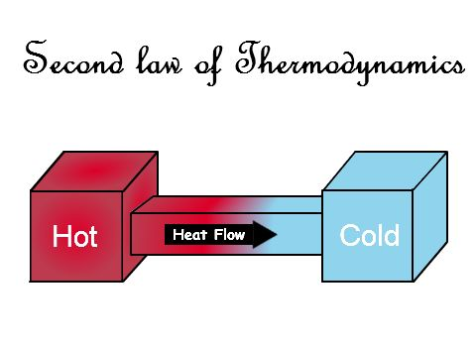
S The Second Law of Thermodynamics
The universe is running out of energy!

Slide 18
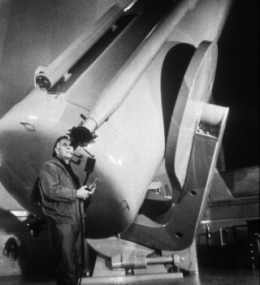
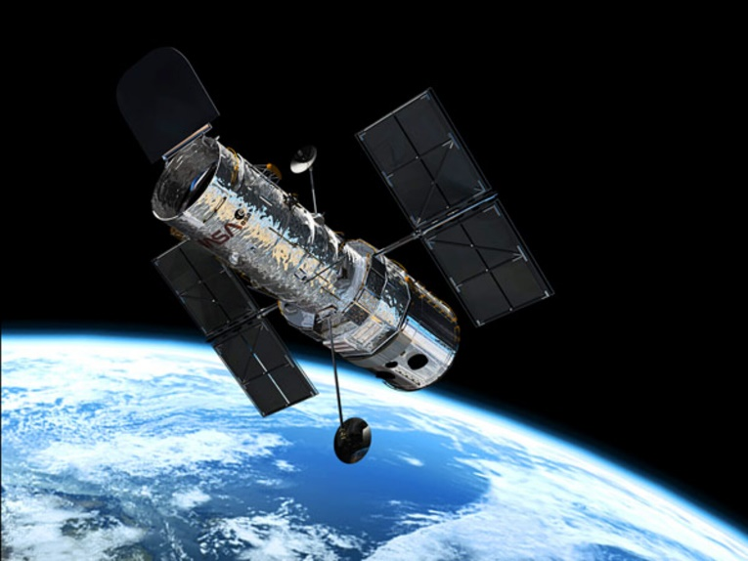
U The Universe is Expanding
In 1929, Astronomer Edwin Hubble observed a red shift in the light from
distant galaxies. That red shift indicated that the galaxies are all moving
away from one another. In other words, the universe is expanding.

Slide 19
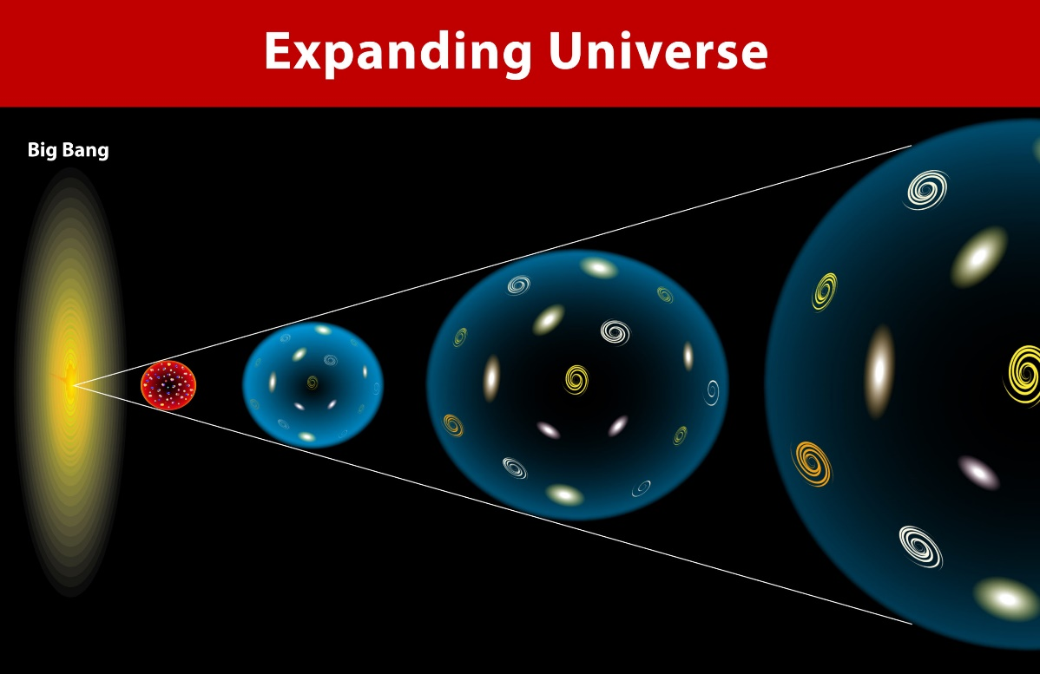
U The Universe is Expanding
How does the expanding universe imply that the universe had a beginning?

Slide 20
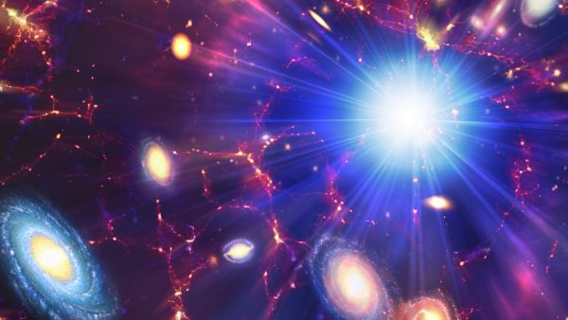
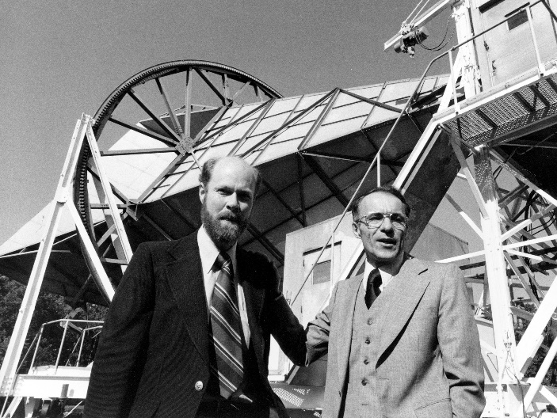
R - The Radiation from the Big Bang
In 1948, scientist predicted that there would be heat left over from the Big
Bang explosion.
Arno Penzias and Robert Wilson, Nobel prize-winning discovery of the
Radiation afterglow in 1965

Slide 21
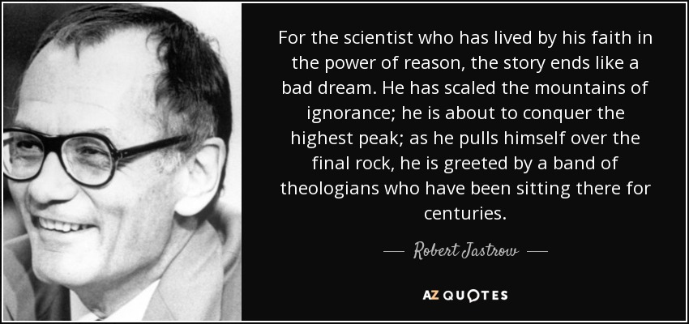
R - The Radiation from the Big Bang
The “steady state” theory claims that the universe is in an eternal steady
State – that the universe did not have a beginning.
Astronomer Robert Jastrow, agnostic scientist

Slide 22
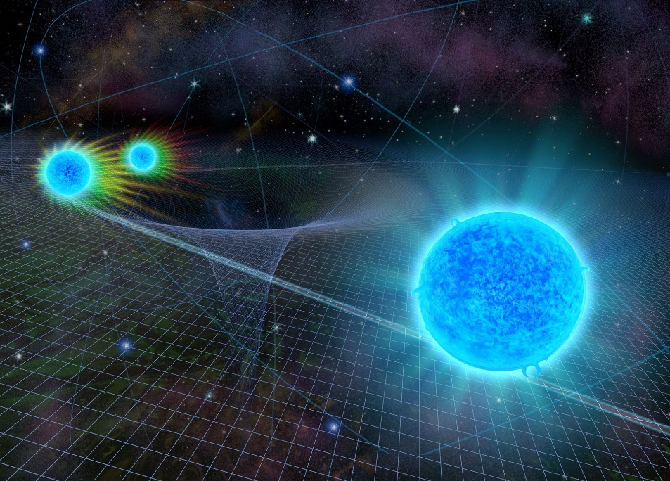
E – Einstein’s Theory of General Relativity
Einstein’s theory of General Relativity shows that time, space, and matter are
co-relative. That is, they are interdependent – they came into existence
together.

Slide 23
The Argument for a Theistic God
Attributes about the First Cause so far!
First Cause is:
Spaceless?
Since space was created, the cause must be spaceless
Timeless?
Since time was created, the cause must be timeless
Immaterial?
Since material (matter) was created, the cause must be immaterial
Powerful?
Since the entire universe was created out of nothing, the cause must be
extremely powerful
Intelligent?
Since the creation event was extremely fine-tuned (and remains so to this day)
The Designer must be extremely intelligent

Slide 24
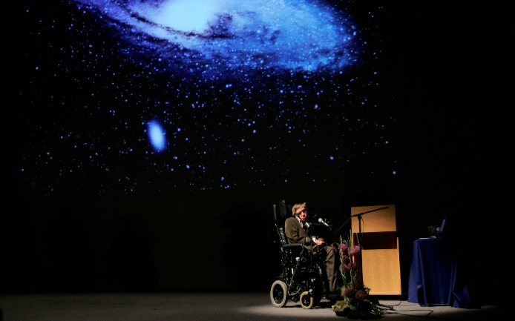
Who Made God?
Atheist often ask such question!
The universe, however, did have a beginning and thus needs a cause. Before
the discovery of the big bang, atheist had no problem asserting that the
universe was eternal and didn’t need a cause. So why do they have a problem
with an eternal, uncaused God?
“Almost everyone now believes that the universe, and time
Itself, had a beginning at the
Big Bang.”
Atheist Stephen Hawking

Slide 25
Does God Exist?
Divine Design
Romans 1:20
For since the creation of the world His invisible
Attributes, His eternal power and divine nature,
Have been clearly seen, being understood through what has been made, so that they are without excuse.
ALLPPT.com _ Free PowerPoint Templates, Diagrams and Charts

Slide 26

The Teleological Argument
Points to facts that show the “Big Bang” was not a random explosion, but one that was extremely fine-tuned. It also points out how our universe operates
right now implies design as well.

Slide 27
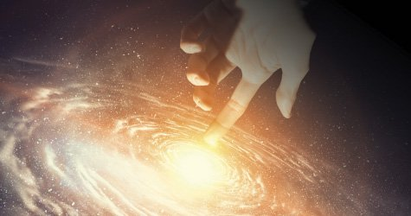
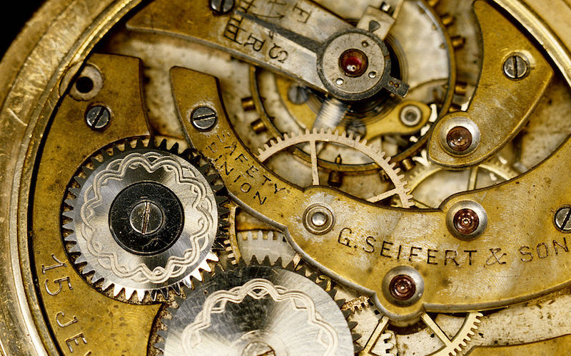
The Teleological Argument
Every design has designer
The universe has highly complex design
Therefore, the universe has a Designer

Slide 28
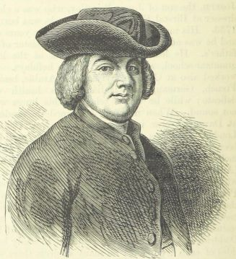
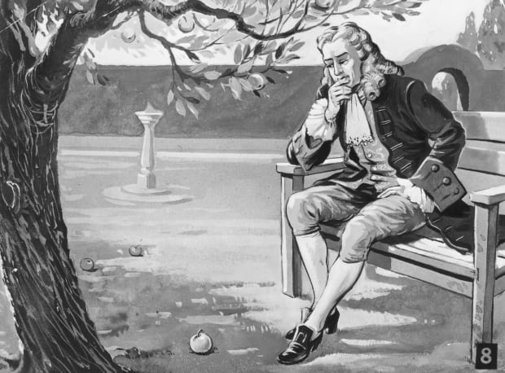
The Teleological Argument
Psalm 19:1
“The heavens declare the glory of God; the skies proclaim the work of His hands.”
Isaac Newton
William Paley

Slide 29
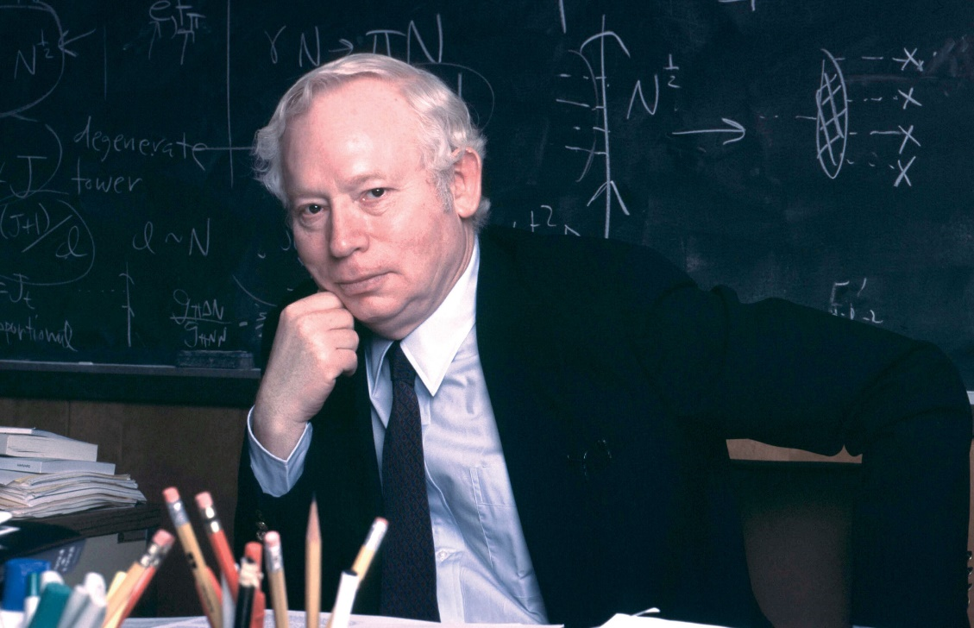
God? Look to Heavens
“Life as we know it would be impossible if any one of several physical
quantities had slightly different values.”
Steven Weinberg
atheist physicist

Slide 30
Does God Exist?
The Moral Law
For when Gentiles who do not have the Law
do instinctively the things of the Law,
these, not having the Law, are a law to
themselves, in that they show the work of the Law written in their hearts, their conscience bearing witness, and their thoughts alternately accusing or else defending them …..
Romans 2:14-15
ALLPPT.com _ Free PowerPoint Templates, Diagrams and Charts

Slide 31
Does God Exist?
The Moral Law
The Moral Law Argument states:
1. Every law has a law giver
2. There is an objective moral law
3. Therefore, there is an objective moral law giver
Here is another way to state the argument:
1. If God does not exist, objective moral values do not exist
2. Objective moral values do exist
3. Therefore, God exists

Slide 32
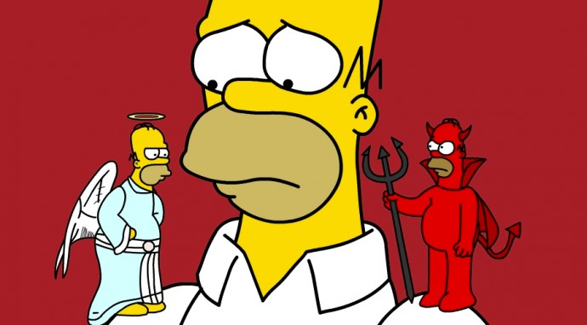
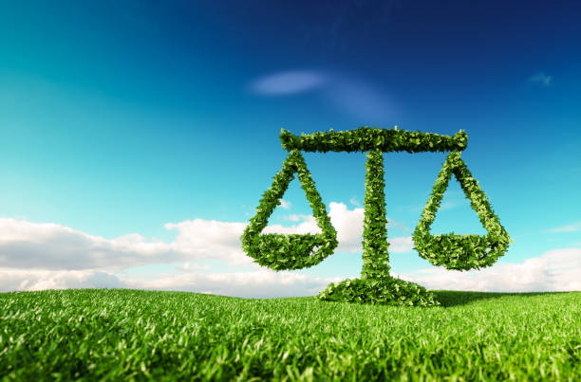
Does God Exist?
The Moral Law
Some call the Moral Law “conscience” and others call it “Nature’s Law.”

Slide 33
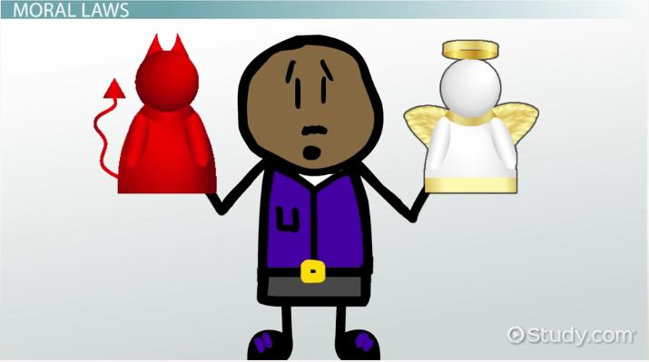

Does God Exist?
The Moral Law: Is there a standard?

Slide 34
Does God Exist?
The Moral Law: Is there a standard?
Are laws against murder and other crimes just based on someone’s opinion?
If opinion changes, is it okay to change these laws to permit such behavior?
If there is no God, then who decides what is right and wrong?
Is it Mother Teresa or Hitler? Is it you? Me? Who gets to decide?

Slide 35
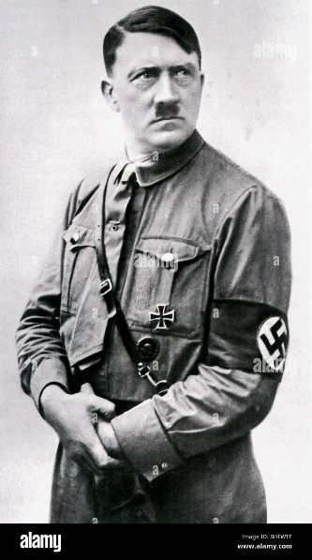
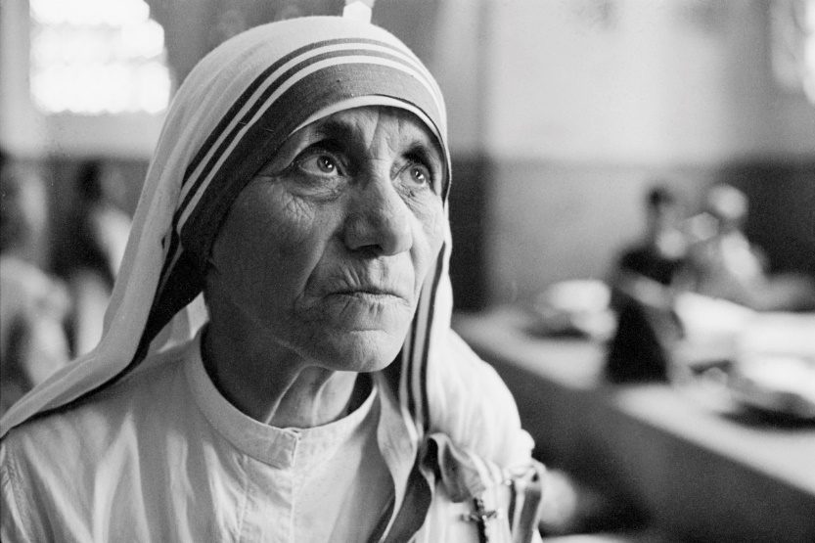
Does God Exist?
The Moral Law: Knowing vs. Grounding the Moral Law
Hitler vs Mother Teresa

Slide 36
Does God Exist?
The Moral Law: If we denied objective morality (no God)
The Nazis were not really wrong.
Love is no better than rape.
Freedom is not better than slavery.
Religious crusades are not wrong.
Tolerance is no better than intolerance.
There is no such thing as evil (because there can’t be evil unless there is Good and there can’t be Good unless God exists)

Slide 37
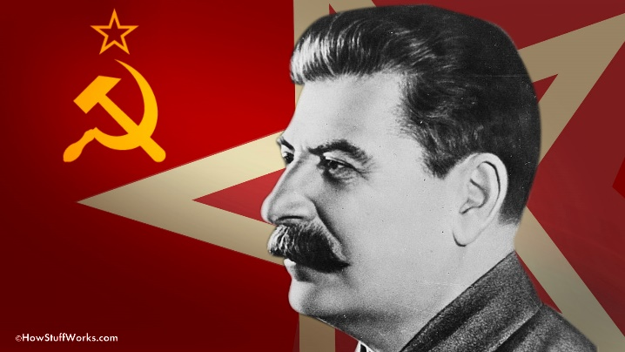
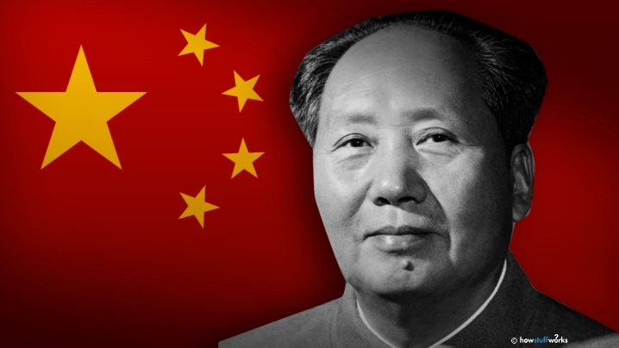
Does God Exist?
The Moral Law: What do Darwinists say?
Finally, who said we ought to “cooperate” and why should I cooperate if I can get what I want by not cooperating?
The Russian dictator Stalin got what he wanted by murdering other people. He didn’t need to cooperate nor Chinese dictator Mao.

Slide 38
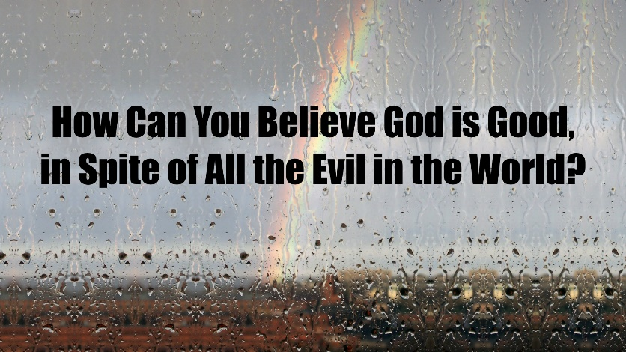

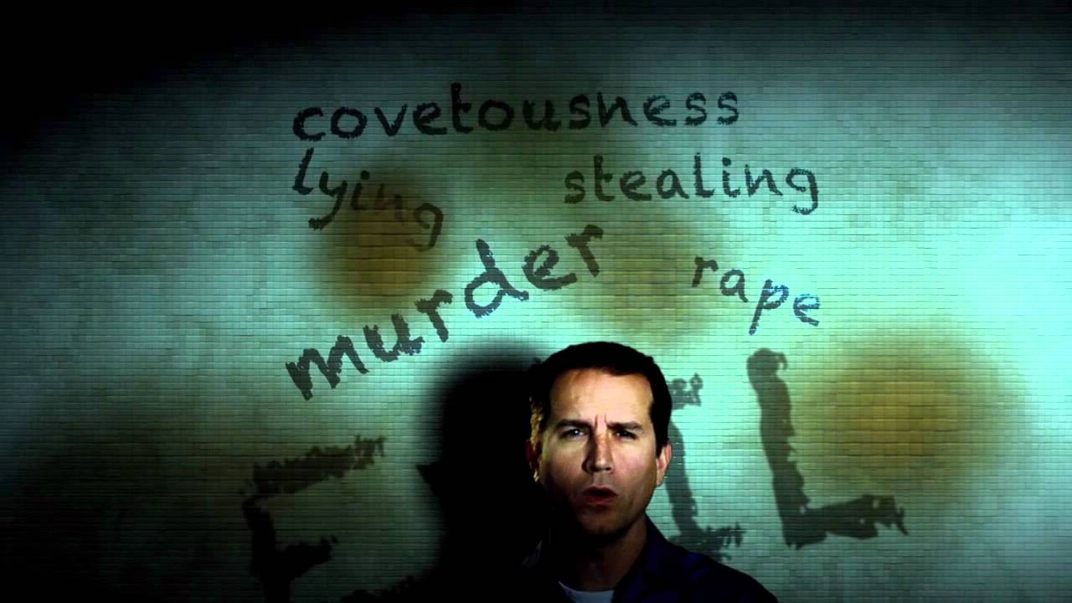
Does God Exist?
The Moral Law: What about Evil?
CS Lewis
“Mere Christianity”

Slide 39
God’s Unshared
Attributes
ALLPPT.com _ Free PowerPoint Templates, Diagrams and Charts

Slide 40
God’s Unshared Attributes
Classification
Some theologians divide their discussions between certain attributes (What God is like) and activities (What God does)
Other theologians see certain attributes as absolute and
others as relative
This typically has to do with attributes that uniquely belong to God and those he shares with his human
creations

Slide 41
God’s Unshared Attributes
Classification
“How is God not like us?”
“How are we similar to God?”

Slide 42
God’s Unshared Attributes
간단
1. Simplicity / Unity / Perfection (간단 / 단일성 / 완전)

Slide 43
God’s Unshared Attributes
간단
Simplicity / Unity / Perfection (간단 / 단일성 / 완전)
Incorporeality (무체성)

Slide 44
God’s Unshared Attributes
간단
Simplicity / Unity / Perfection (간단 / 단일성 / 완전)
Incorporeality (무체성)
Incomprehensibility (이해할수없음)

Slide 45
God’s Unshared Attributes
간단
Simplicity / Unity / Perfection (간단 / 단일성 / 완전)
Incorporeality (무체성)
Incomprehensibility (이해할수없음)
Uncreated (생성되지않은)

Slide 46
God’s Unshared Attributes
간단
Simplicity / Unity / Perfection (간단 / 단일성 / 완전)
Incorporeality (무체성)
Incomprehensibility (이해할수없음)
Uncreated (생성되지않은)
Creator (창조자)

Slide 47
God’s Unshared Attributes
간단
Simplicity / Unity / Perfection (간단 / 단일성 / 완전)
Incorporeality (무체성)
Incomprehensibility (이해할수없음)
Uncreated (생성되지않은)
Creator (창조자)
Eternality (영원)

Slide 48
God’s Unshared Attributes
간단
Simplicity / Unity / Perfection (간단 / 단일성 / 완전)
Incorporeality (무체성)
Incomprehensibility (이해할수없음)
Uncreated (생성되지않은)
Creator (창조자)
Eternality (영원)
Immortality (불사)

Slide 49
God’s Unshared Attributes
간단
Simplicity / Unity / Perfection (간단 / 단일성 / 완전)
Incorporeality (무체성)
Incomprehensibility (이해할수없음)
Uncreated (생성되지않은)
Creator (창조자)
Eternality (영원)
Immortality (불사)
Immanence (내재)

Slide 50
God’s Unshared Attributes
간단
Simplicity / Unity / Perfection (간단 / 단일성 / 완전)
Incorporeality (무체성)
Incomprehensibility (이해할수없음)
Uncreated (생성되지않은)
Creator (창조자)
Eternality (영원)
Immortality (불사)
Immanence (내재)
Transcendence (초월)

Slide 51
God’s Unshared Attributes
간단
Simplicity / Unity / Perfection (간단 / 단일성 / 완전)
Incorporeality (무체성)
Incomprehensibility (이해할수없음)
Uncreated (생성되지않은)
Creator (창조자)
Eternality (영원)
Immortality (불사)
Immanence (내재)
Transcendence (초월)
Omnipresence (편재)

Slide 52
God’s Unshared Attributes
간단
Simplicity / Unity / Perfection (간단 / 단일성 / 완전)
Incorporeality (무체성)
Incomprehensibility (이해할수없음)
Uncreated (생성되지않은)
Creator (창조자)
Eternality (영원)
Immortality (불사)
Immanence (내재)
Transcendence (초월)
Omnipresence (편재)
Independence (독립)

Slide 53
God’s Unshared Attributes
간단
Infinitude (무한)

Slide 54
God’s Unshared Attributes
간단
Infinitude (무한)
Immutability (불변성)

Slide 55
God’s Unshared Attributes
간단
Infinitude (무한)
Immutability (불변성)
Omnipotence (전능)

Slide 56
God’s Unshared Attributes
간단
Infinitude (무한)
Immutability (불변성)
Omnipotence (전능)
Omniscience (전지)

Slide 57
God’s Unshared Attributes
간단
Infinitude (무한)
Immutability (불변성)
Omnipotence (전능)
Omniscience (전지)
Providence/Sovereignty (섭리/주권)

Slide 58
God’s Shared Attributes
간단
Personhood (인격)

Slide 59
God’s Shared Attributes
간단
Personhood (인격)
Rationality (합리성)

Slide 60
God’s Shared Attributes
간단
Personhood (인격)
Rationality (합리성)
Holiness (신성한것)

Slide 61
God’s Shared Attributes
간단
Personhood (인격)
Rationality (합리성)
Holiness (신성한것)
Righteousness (정당성)

Slide 62
God’s Shared Attributes
간단
Personhood (인격)
Rationality (합리성)
Holiness (신성한것)
Righteousness (정당성)
Just / Justice (판사)

Slide 63
God’s Shared Attributes
간단
Personhood (인격)
Rationality (합리성)
Holiness (신성한것)
Righteousness (정당성)
Just / Justice (판사)
Goodness (선량)

Slide 64
God’s Shared Attributes
간단
Personhood (인격)
Rationality (합리성)
Holiness (신성한것)
Righteousness (정당성)
Just / Justice (판사)
Goodness (선량)
Love (사랑)

Slide 65
God’s Shared Attributes
간단
Personhood (인격)
Rationality (합리성)
Holiness (신성한것)
Righteousness (정당성)
Just / Justice (판사)
Goodness (선량)
Love (사랑)
Grace (은혜)

Slide 66
God’s Shared Attributes
간단
Personhood (인격)
Rationality (합리성)
Holiness (신성한것)
Righteousness (정당성)
Just / Justice (판사)
Goodness (선량)
Love (사랑)
Grace (은혜)
Mercy (자비)

Slide 67
God’s Shared Attributes
간단
Personhood (인격)
Rationality (합리성)
Holiness (신성한것)
Righteousness (정당성)
Just / Justice (판사)
Goodness (선량)
Love (사랑)
Grace (은혜)
Mercy (자비)
Freedom (자유)

Slide 68
God’s Shared Attributes
간단
Personhood (인격)
Rationality (합리성)
Holiness (신성한것)
Righteousness (정당성)
Just / Justice (판사)
Goodness (선량)
Love (사랑)
Grace (은혜)
Mercy (자비)
Freedom (자유)
Truthfulness/Faithfulness (진실성/충실)

Slide 69
God’s Shared Attributes
간단
11. Wisdom (지혜)

Slide 70
God’s Shared Attributes
간단
11. Wisdom (지혜)
12. Order/Peace (Shalom) (평화)

Slide 71
God as Trinity
간단
Trinity (삼위일체)

Slide 72
God as Trinity
간단
Trinity (삼위일체)
God’s Uniqueness (하나님 유일성)

Slide 73
God as Trinity
간단
Trinity (삼위일체)
God’s Uniqueness (하나님 유일성)
God the Father (하나님 아버지)

Slide 74
God as Trinity
간단
Trinity (삼위일체)
God’s Uniqueness (하나님 유일성)
God the Father (하나님 아버지)
God the Son (하나님 아들)

Slide 75
God as Trinity
간단
Trinity (삼위일체)
God’s Uniqueness (하나님 유일성)
God the Father (하나님 아버지)
God the Son (하나님 아들)
God the Holy Spirit (성령 하나님)

Slide 76
God as Trinity
간단
Trinity (삼위일체)
God’s Uniqueness (하나님 유일성)
God the Father (하나님 아버지)
God the Son (하나님 아들)
God the Holy Spirit (성령 하나님)
a. The Personhood of the Holy Spirit (성령의 인격)

Slide 77
God as Trinity
간단
Trinity (삼위일체)
God’s Uniqueness (하나님 유일성)
God the Father (하나님 아버지)
God the Son (하나님 아들)
God the Holy Spirit (성령 하나님)
The Personhood of the Holy Spirit (성령의 인격)
The Deity of the Holy Spirit (성령의 신성)

Slide 78
Articulating Trinitarianism
간단
Articulating Trinitarianism (삼위일체론을 분명하게 표현하다)

Slide 79
Articulating Trinitarianism
간단
Articulating Trinitarianism (삼위일체론을 분명하게 표현하다)
a. Dynamic Monarchianism
b. Modalistic Monarchianism/modalism (양태론적 삼위일체)

Slide 80
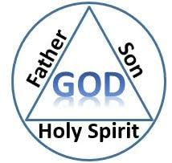
Articulating Trinitarianism
간단
God is three persons
Each person is fully God
There is one God

